Slide 1

Brooklyn Explorers Program
Training (Day 2) – January 17, 2013
Partnership for After School Education (PASE)
120 Broadway, Suite 230, New York, NY 10271
Ph: 212-571-2664 Fx: 212-571-2676
Website: www.pasesetter.org
Notes:
9:00-9:15 (15 min) -- Yvonne & Julia
Welcome Back
Reintroduce names

Slide 2
Agenda Overview
Main Activities:
Neighborhood walk
Practicing using the web tools
Planning for program implementation
By site and with partner site
Evaluations and Certificates
Notes:
9:00-9:15 (15 min) -- Yvonne
Welcome Back
Reintroduce names
Agenda Overview

Slide 3
Icebreaker: Neighborhoods A - Z
In teams, list one word per letter of the alphabet that comes to mind when you think of neighborhoods or communities.
You have 2 minutes!
Notes:
9:00-9:15 (15 min) -- Yvonne
Welcome Back
Icebreaker

Slide 4
Neighborhood Walk: Route
Notes:
9:15-10:00 (45 min) – Yvonne & Julia
Distribute and review map with walking route
This is meant to be a condensed version of what you would do with youth in your program
Distribute/review list of community assets
Julia – distribute and review Media Gathering Tool

Slide 5
Neighborhood Walk: What You Need
Please bring
Neighborhood map with walking route
Media Gathering Template
Community Assets List
Building passes with identification
Valuables
Notes:
9:15-10:00 (45 min) – Yvonne & Julia
Review list of what to bring
Take neighborhood walk, highlighting assets that may be off the walking route
Participants gather media during the walk
Along the way discuss
Reviewing safety protocols with kids
Getting additional chaperones
Dividing into teams (writers, photographers, cartographers, etc)
10:00-10:10 BREAK

Slide 6
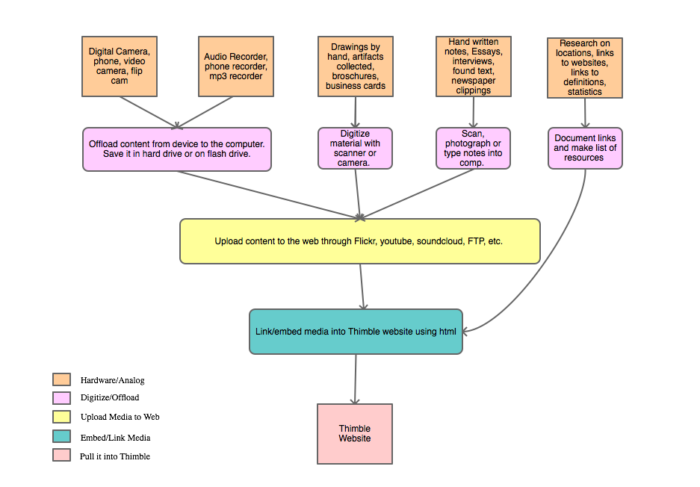
Transferring Content to Thimble
Media Flow Chart
Notes:
10:10 - 10:55 (40 min) --Julia
Guide participants through transferring their media to web-based applications. Demonstrate with examples. Direct them to flow chart hand-out. Demo with Phone/camera/web/thimble.

Slide 7
Practice Using Web Tools
Lets try it together!
https://thimble.webmaker.org/p/f7e6/edit
Notes:
10:55 – 12:00 (65 min) – Julia
In teams, participants have 60 minutes to practice building thimble sites and bringing media into the site.
Julia will demo for the first 30 minutes so participants can follow along.
12:00-12:30 LUNCH BREAK
12:30 – 1:00 (30 min) – Julia
Sharing
Participants share their work and discuss questions/concerns as a group.

Slide 8
Program Action Planning
Program Site Planning (25 minutes)
Gather as program sites to consider implementation timeline, staffing, resources needed, decisions that need to be made and how you will create focus and structure for the project.
Cross Site Planning (15 minutes)
Meet with partner agency to review implementation timelines, determine possible dates for cross-site visits and dates for information sharing in preparation for cross-site visits
Large group report out (10 minutes)
Notes:
1:00 - 1:50 (50 min) Yvonne
25 min: In site teams participants discuss how they will create focus and structure for the project - how they plan to implement it at their site.
15 min: Sites work with their matches to plan for cross site visits.
10 min: Sites report out

Slide 9
Closing and Wrap Up
Closing Activity
Announcements
Site visits and technical assistance
Stipends
Evaluations
Certificates
Notes:
1:45 - 2:00 (15 min) –Yvonne
Closing and Wrap up
Closing activity (5 min):

